Slide 1
Unique Corns
Parth Champaneri, Allen Hsiao, Clare Kim,
Pascal Queeney, Patrick Tan

Slide 2
Findings from the Prototype

Slide 3
Low Fidelity Prototype
Top 3 Heuristics
#1 Visibility of System Status
#2 Match between system + real world
#10 Help + Documentation
User tests reveal there are many overlapping issues with the low fidelity prototype

Slide 4


Visibility of System Status
Minimalistic design
Overall intuitive navigation
Too minimalistic for new users
Wording/ icons are ambiguous
Unclear what actions were made
“My Events”
“Ignore”

Slide 5



System vs. Real World
Searching with a map
“My Calendar” as an page for events

Slide 6

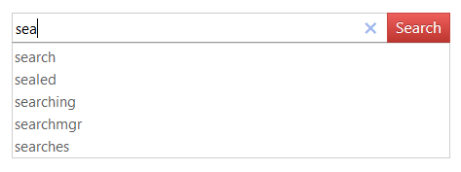
Help + Documentation
Problems:
Lots of functionality
Help should be provided for new users
Recommendations, suggestions

Slide 7

Solutions
Display should never be an empty screen
Include suggestions + documentation
Calendar page should look like a calendar
Fix ambiguous wording
Provide a tutorial / step-by-step instructions for new users

Slide 8
Design of Experiment

Slide 9
Target Audience
Instruments
Protocol
U of T Students, both gender, aged 18-24
Computer, Phone, Camera, Stopwatch
(For notetaking, and for prototype)
Introductions, fill out consent + demographic information
General run through of the prototype
Explain the task (create an event/ attend an event) with the given condition.
Record the amount of time spent to finish the task

Slide 10
Prototype

